Slide 1
DEEP LEARNING FOR SPEECH PROCESSING (21DS704) Music Generation using GAN (MusicGAN) TEAM 3 By: NishitKumar Prajapati (CB.EN.P2DSC21018) Srivatsan Kalyanaraman (CB.EN.P2DSC21028)

Slide 2

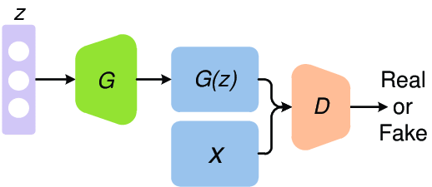

OVERVIEW
Dataset
Preprocessing
Deep Learning
GAN Loss Function
Results

Slide 3
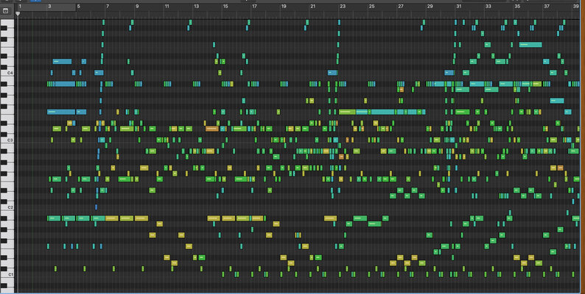
DATASET
174K+ datapoints
Musical Instrument Digital Interface (MIDI)
Each data point consists songs encoded in a MIDI file.
MIDI is a file format that provides a standardized way:
To save music sequences
Transport sequences
Accessed in other systems.

Slide 4
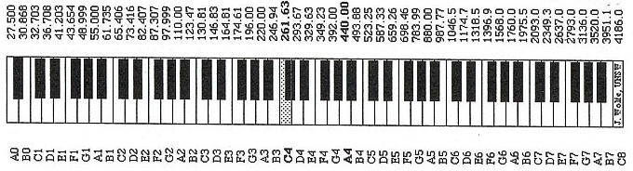
Features from MIDI files
Notes and Chords are hard to visualize in mp3 or wav file formats
Notes
There are 128 possible notes in MIDI format
Notes can represent pitch and duration of a sound
It can also represent the pitch class
Chords
Any harmonic set of pitches/frequencies consisting of multiple notes
A chord is created when more than one note is played at once

Slide 5
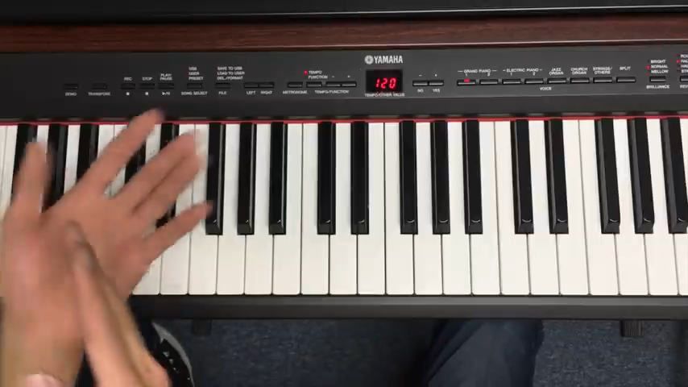
VIDEO
Notes and Chords

Slide 6
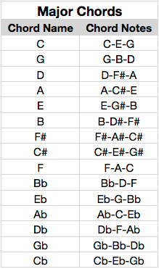
Preprocessing
Extraction of Notes (Pitches)
Notes are extracted by the detection of an offset for a particular duration
Similar extraction process is applied to chords
Conversion of MIDI 2 IMAGE:
Detecting Instrument’s name as per the pitch detected.

Slide 7
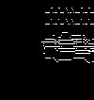
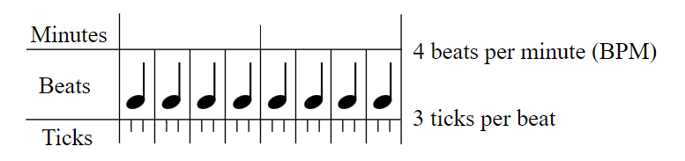
Converting MIDI to image of (106, 100) size
106 different notes:
From 21 (A0) to 127 (G9)
100 – length of the song
RESOLUTION – Each pixel represents a note played for quarter beats
Piano notes are extracted and converted into image

Slide 8
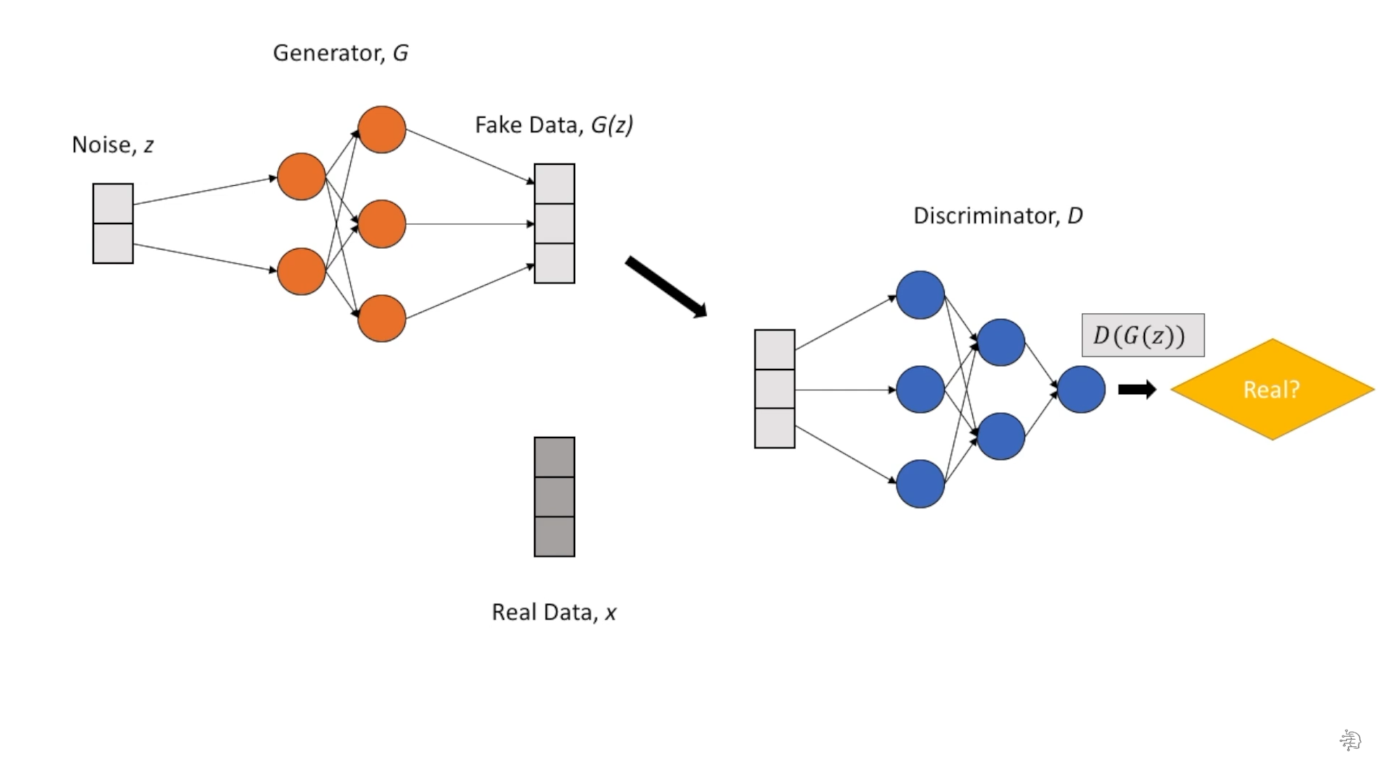
Generative Adversarial Networks
Generator
Learns to create fake data by incorporating feedback from the discriminator
Discriminator
Simply a classifier
Tries to distinguish real data from the one created by generator

Slide 9
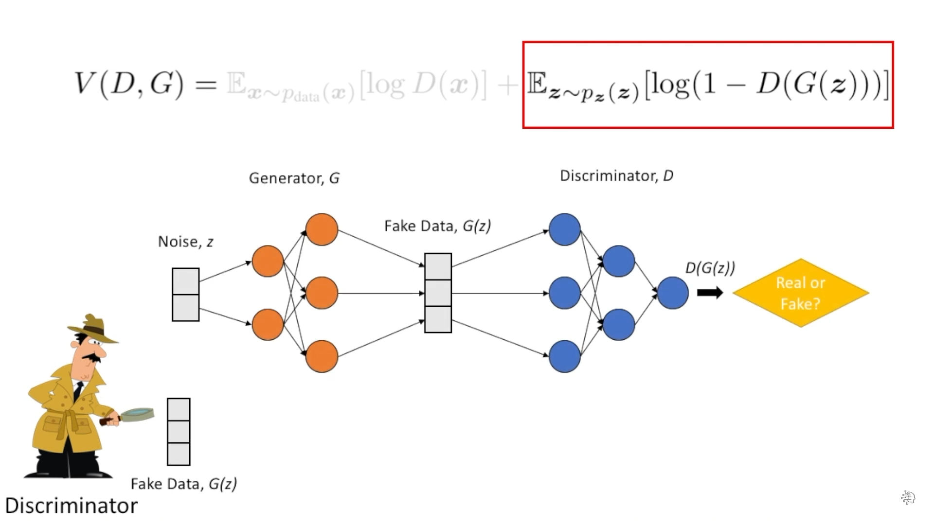
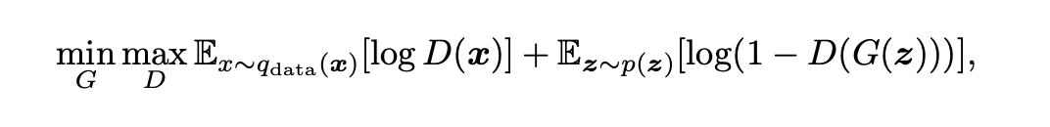
Loss Function of GAN

Slide 10
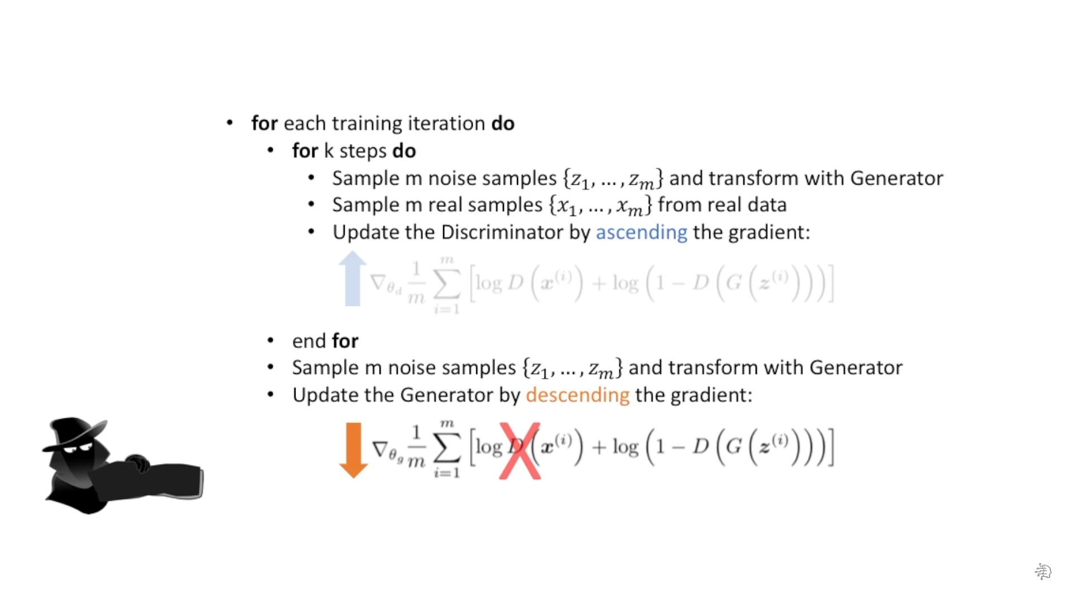

Slide 11

Results

